Slide 1
Research Methods, 2024-2025 Final Project Pitch Talk
Enhancing Translation From Hebrew to Low-Resource Languages Through an English Intermediary Approach
Group 2
Atalia Solash
Shir Mashiah
Erica Rusonik
Amit Fridman

Slide 2

Problem Definition
Limited parallel corpora for underrepresented languages
Hebrew translation research remains unexplored, especially for low-resource languages
The potential of pivot-based methods for Hebrew is untested

Slide 3
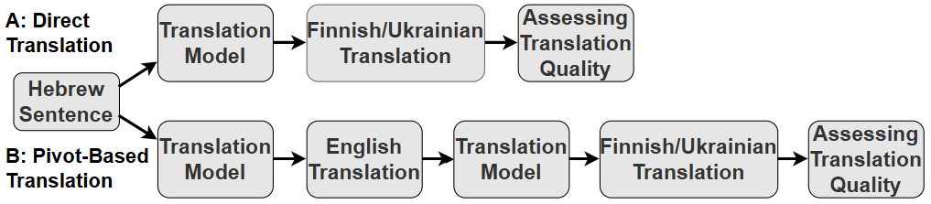
Methodology
Research Objective:
Enhance translation quality from Hebrew to low-resource languages
Compare effectiveness between direct and pivot translation approaches
Translation Pipeline:
Direct Method: Hebrew → Target Language
Pivot Method: Hebrew → English → Target Language
Models Evaluated: NLLB-200, Helsinki nlp, Google Translate, Llama 3.1

Slide 4
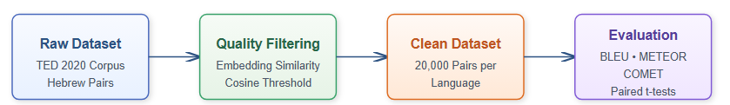
Methodology – Cont’d
Dataset:
TED 2020 corpus (20,000 pairs Hebrew-Finnish/Ukrainian)
Quality filtered using multilingual embeddings with a cosine similarity threshold of 0.75
Quality metrics:
BLEU: n-gram precision
METEOR: semantic matching
COMET: neural evaluation
Statistical significance validated through paired t-tests at sentence level

Slide 5
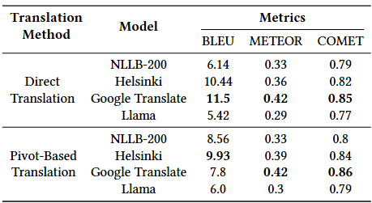
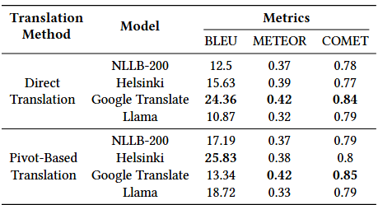
Results
Hebrew-Finnish
Hebrew-Ukrainian
The paired t-test confirmed statistically significant differences, with pivot-based translation outperforming direct translation in all models except NLLB-200.

Slide 6
Conclusions, Limitations & Future Work
Conclusions
Pivot-based translation generally outperformed direct translation in Hebrew-Finnish and Hebrew-Ukrainian pairs.
The choice of translation method and evaluation metrics should align with task-specific priorities.
Limitations
Dependence on English as the sole pivot language restricted the scope of exploration.
Future Work
Exploring alternative pivot languages with closer linguistic ties.
Explore dynamic pivot language selection and hybrid approaches (direct + pivot).

